Slide 1

SPACE-X DATA ANALYZATION PROJECT
Analyze, Predict, Visualize

Slide 2

Overview
Purpose:
Analyze historical launch data
Predict launch success
Visualize trends and patterns
Key Features:
Real-time data processing
Interactive dashboards
ML-driven predictions
Weather impact analysis

Slide 3

System Architecture
Core Components:
Data Preprocessing
Visualization
Machine Learning
Web App
Tech Stack:
Python, Pandas, Scikit-learn
Streamlit (Web), Plotly (Visualization)
SQLite (Database)

Slide 4

Data Preprocessing
Key Tasks:
Load & clean raw data (JSON/CSV)
Feature engineering (payload mass, core reuse)
Validate data quality (schema, range checks)
Output: Structured datasets for ML/analysis.

Slide 5
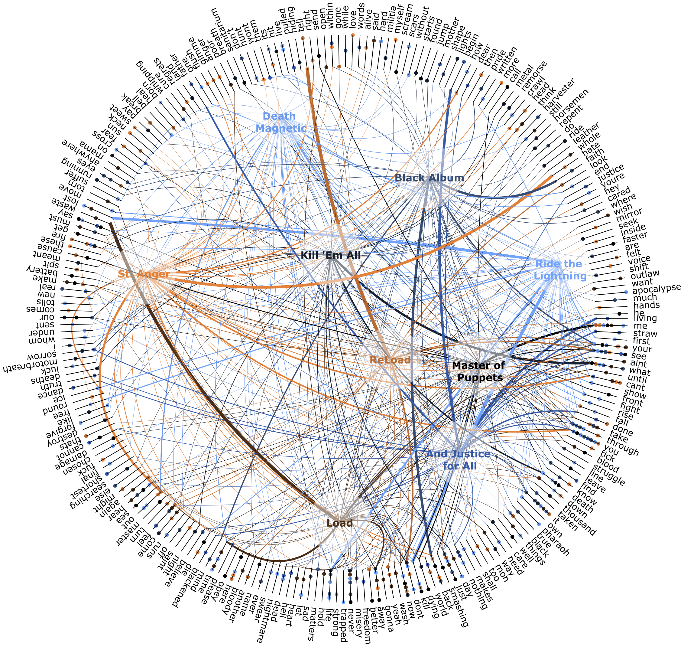
Visualization
Types of Plots:
Launch success rates
Payload mass distribution
Interactive launch site maps
Features:
Real-time updates
Export options

Slide 6
Machine Learning
Model: Random Forest Classifier
Key Metrics:
Accuracy, Precision, F1-Score
Features Used:
Payload mass, weather data, launch site stats

Slide 7

Web Application
Components:
Dashboard with live stats
Prediction interface (input parameters)
Features:
User authentication
Real-time results with confidence scores

Slide 8
Weather Integration
Data Fetched:
Wind speed, temperature, cloud cover
Impact Analysis:
Weather’s role in launch success predictions

Slide 9
Implementation Steps
Install dependencies : pip install –r requirements.txt
Preprocess data : python –m preprocessing.prepare_data
Train model : python –m model.train
Launch App : streamlit run app.py

Slide 10
Conclusion & Future
Value: Comprehensive analysis, reliable predictions.
Future Enhancements:
Deep learning integration
Real-time weather alerts
Mobile-friendly UI

Slide 11
THANK YOU!!

